Slide 1

Deep Reinforcement Learning
Recitation : Advanced RL Algorithms
Huazhe Xu
Credit to: Ray Zheng (TA in 2023Fall)
Tsinghua University

Slide 2
Contents
Soft Actor-Critic (SAC)

Slide 3
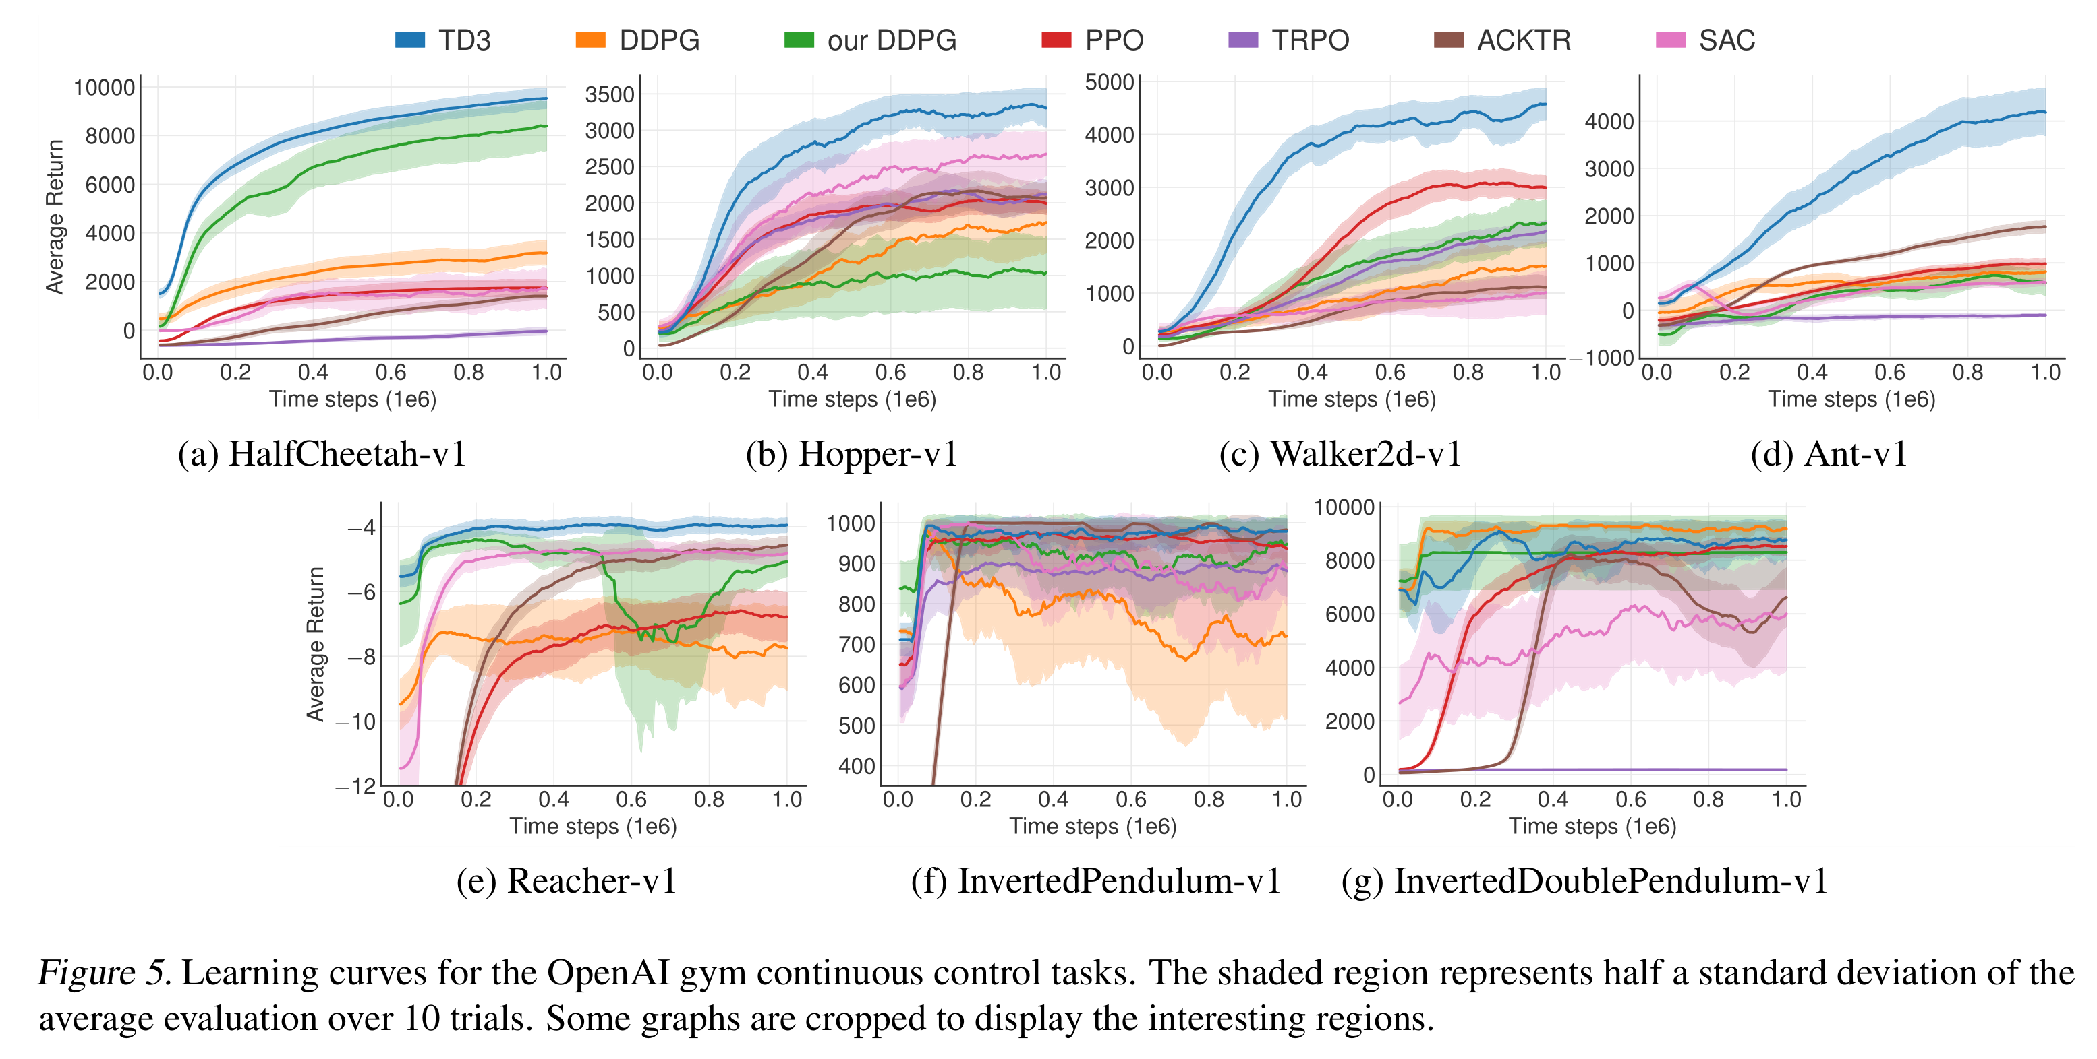
Comparison

Slide 4
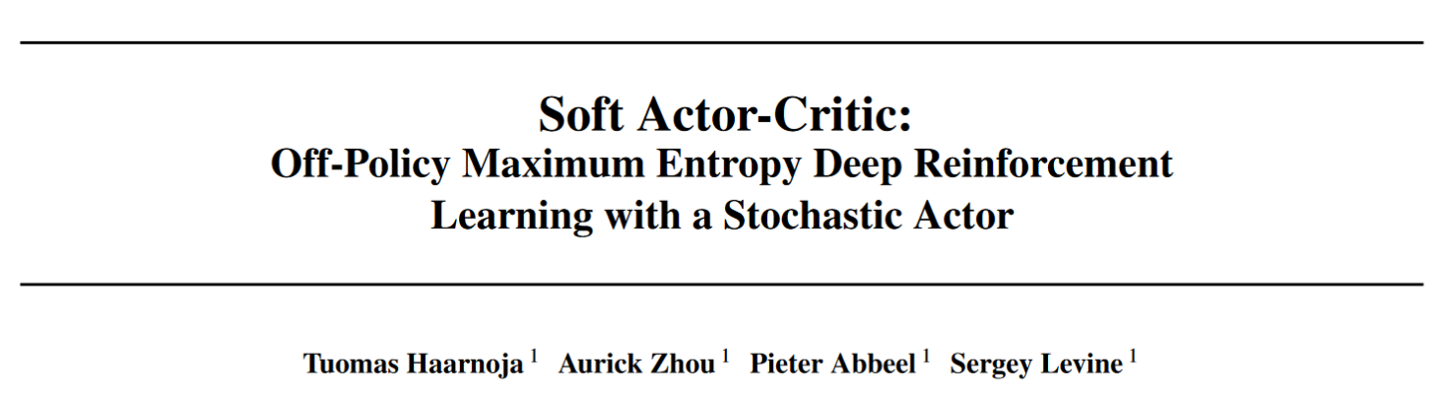

Slide 5
Background: Problems of DDPG
DDPG is extremely difficult to stabilize and brittle to hyperparameter settings.
As a consequence, it is difficult to extend DDPG to complex, high-dimensional tasks.
Sample efficiency could be improved a lot through better exploration.

Slide 6
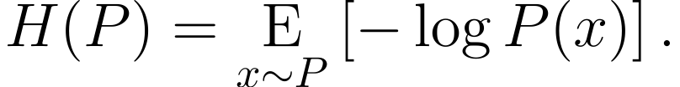
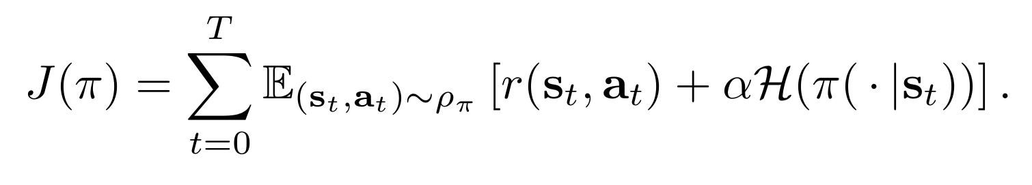
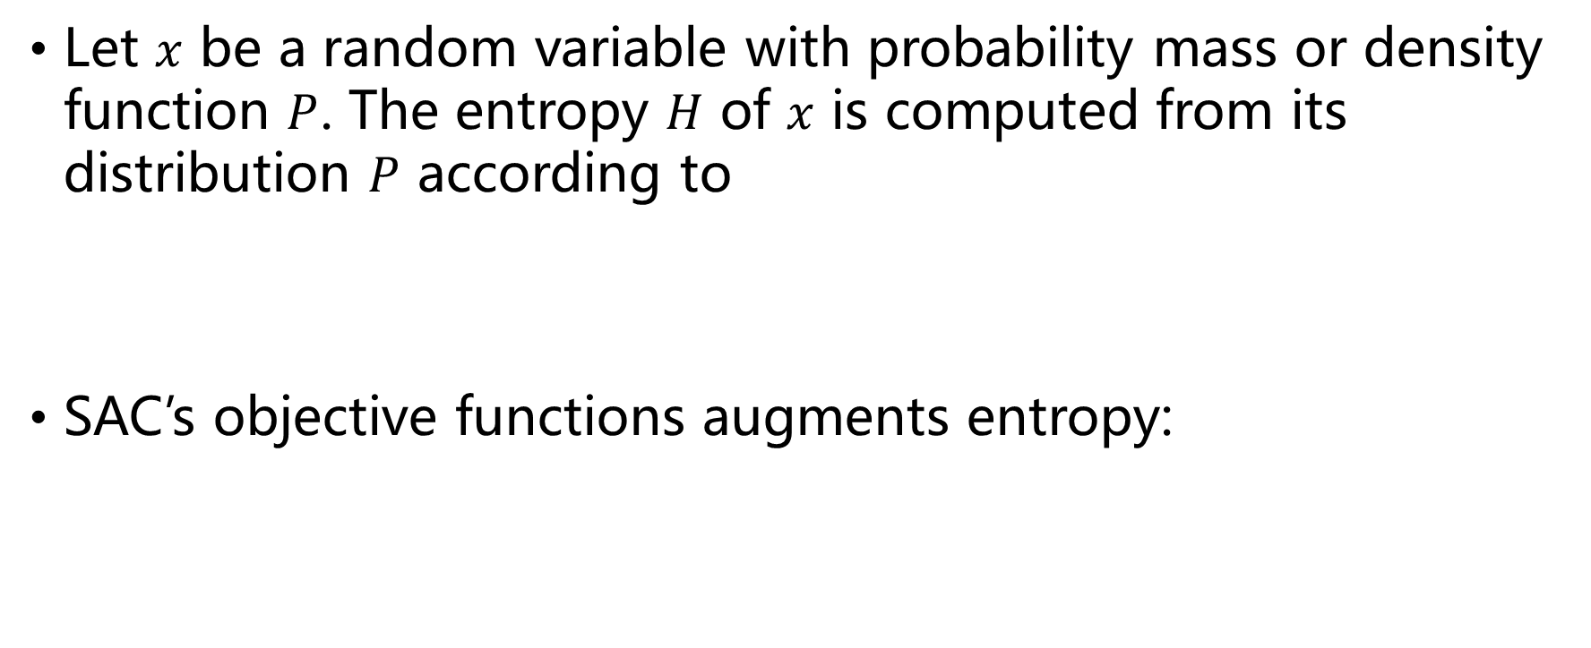
Entropy Regularized RL
Let $x$ be a random variable with probability mass or density function $P$. The entropy $H$ of $x$ is computed from its distribution $P$ according to
SAC’s objective functions augments entropy:

Slide 7
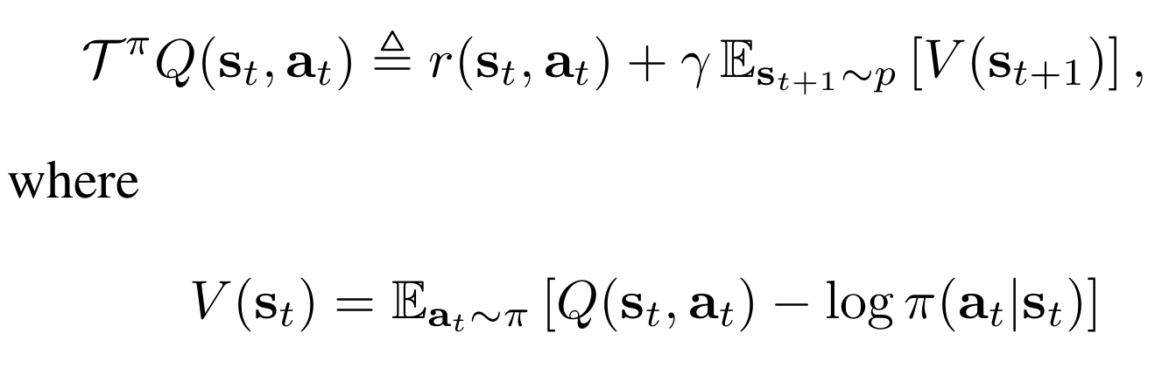
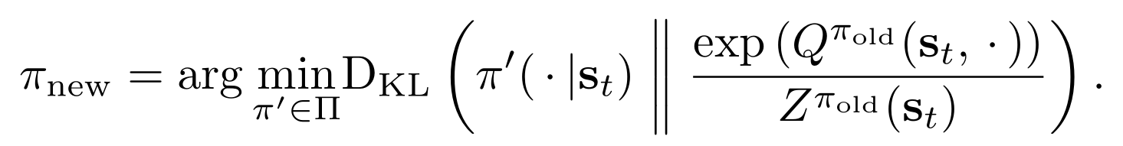
Soft Policy Iteration
Take one stochastic gradient step to minimize soft Bellman residual:
Take one stochastic gradient step to minimize the KL divergence
Repeat until convergence.

Slide 8
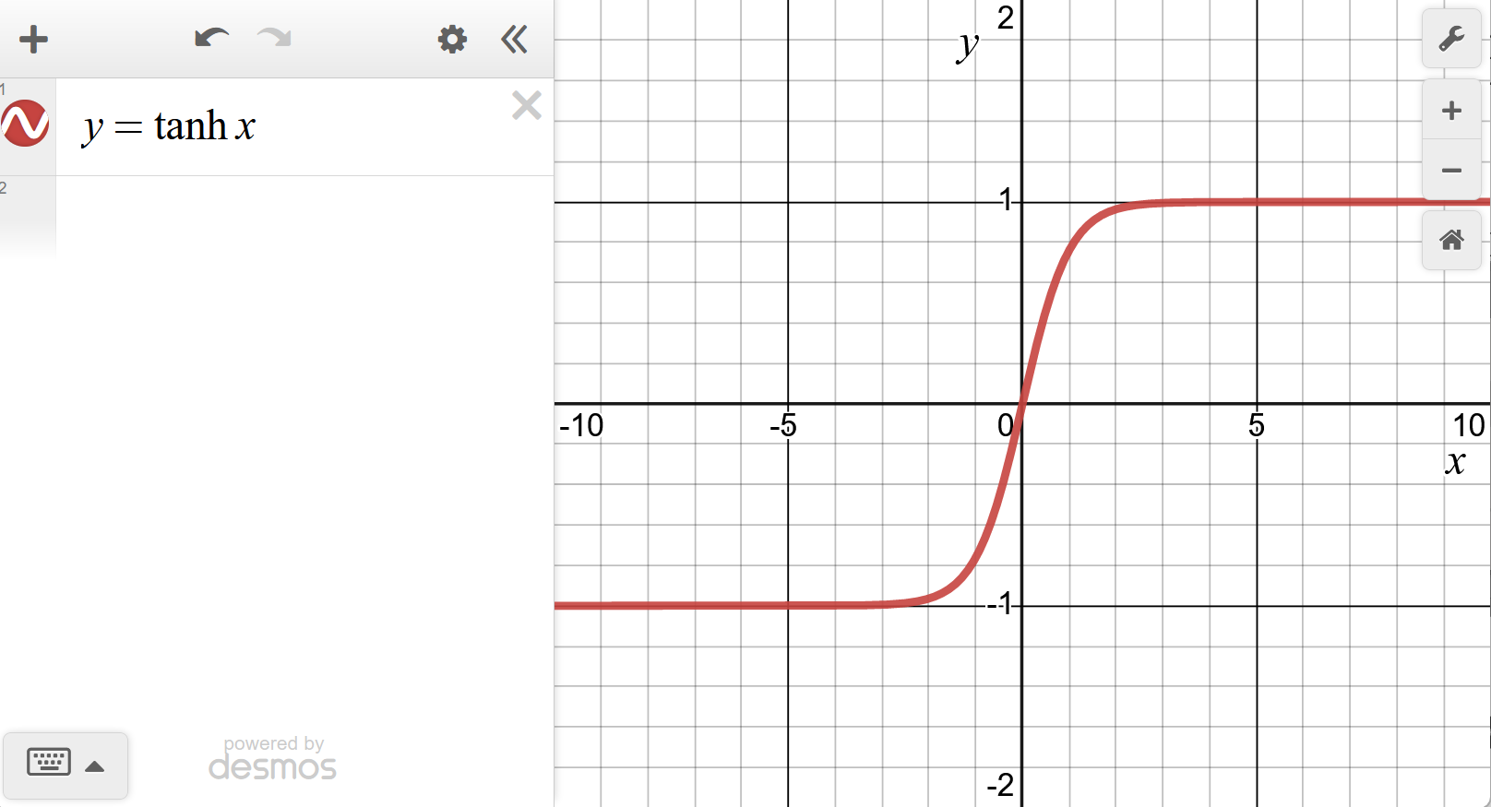
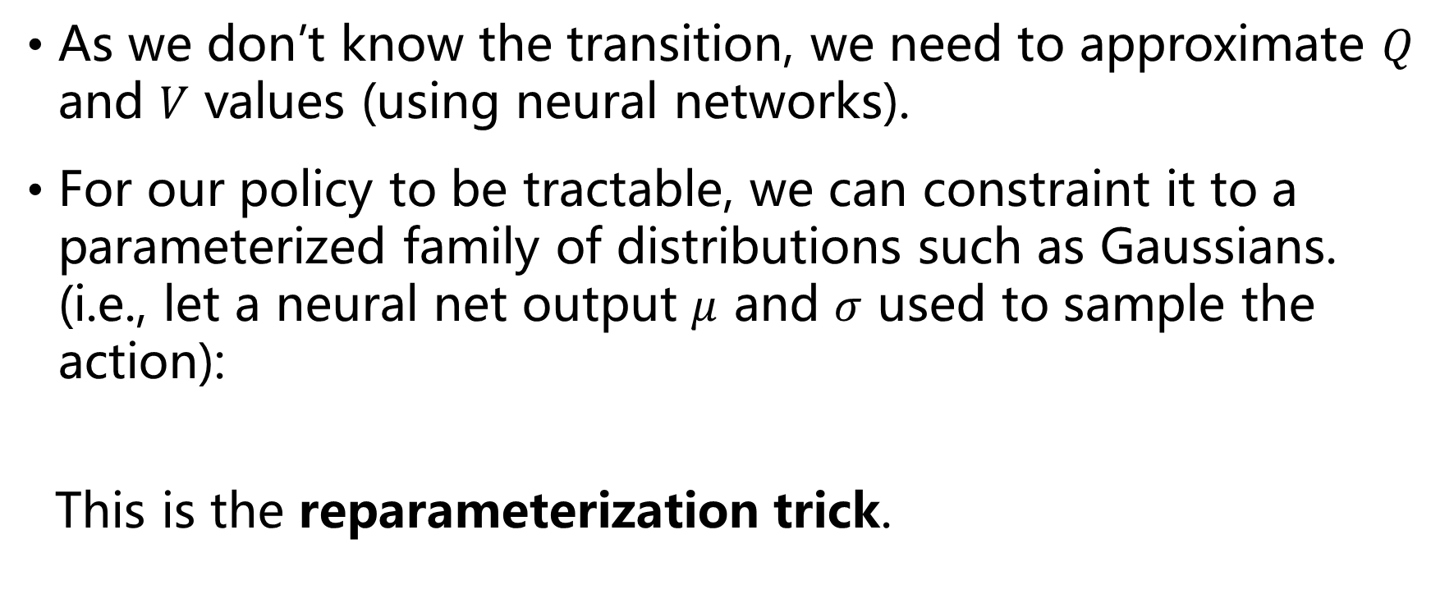
Soft Actor Critic
As we don’t know the transition, we need to approximate $Q$ and $V$ values (using neural networks).
For our policy to be tractable, we can constraint it to a parameterized family of distributions such as Gaussians. (i.e., let a neural net output $μ$ and $σ$ used to sample the action):
This is the reparameterization trick.

Slide 9
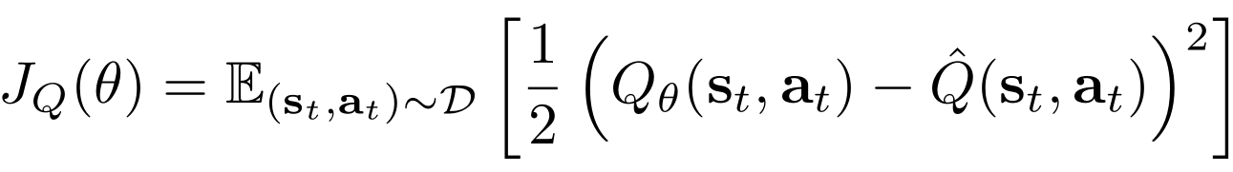
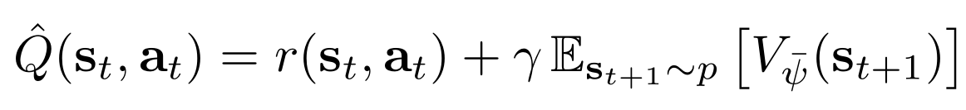
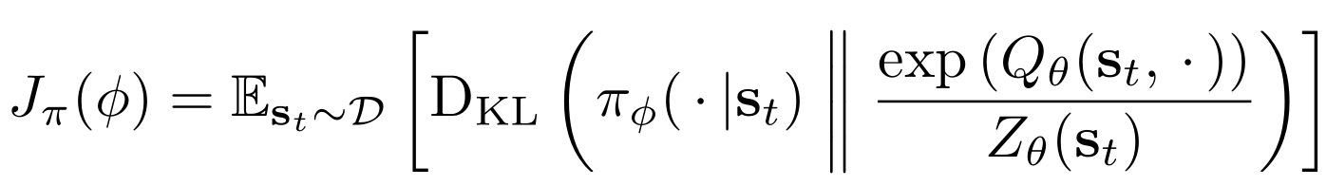

Networks and Objectives
Value network $V_{ψ}\left(s_{t}\right)$, Q-network $Q_{θ}\left(s_{t}, a_{t}\right)$, policy $π_{φ}\left(a_{t} | s_{t}\right).$
Value objective
Q objective
Policy objective

Slide 10
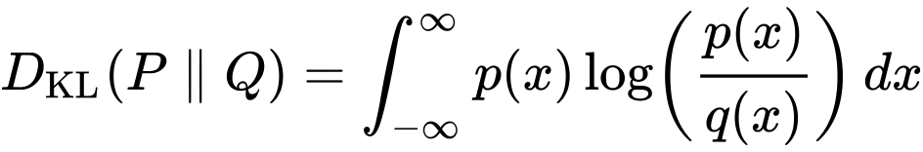
Gradients
Gradient estimate of value objective
Gradient estimate of Q objective
Gradient estimate of policy is a bit tricky. We need to expand definition of KL divergence:

Slide 11
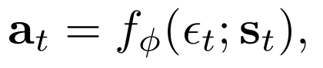
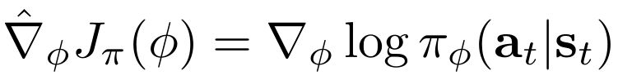
Gradient Estimate of Policy
Policy objective
Reparameterization trick
Together:

Slide 12
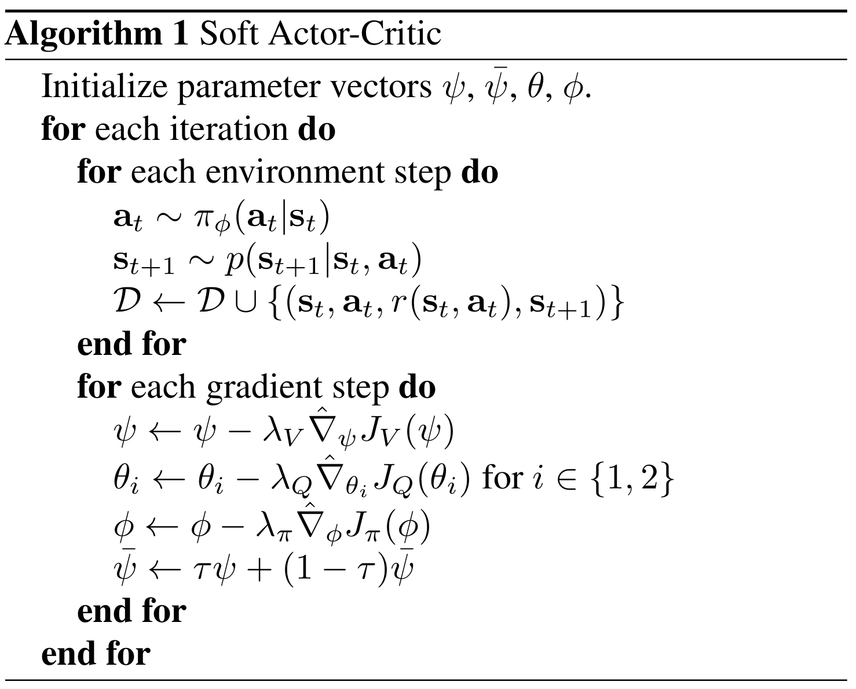
Other Tricks
Target Q-networks
Polyak averaging
Clipped double-Q
(taken from TD3!)
No need to smoothen target policy. Why?

Slide 13
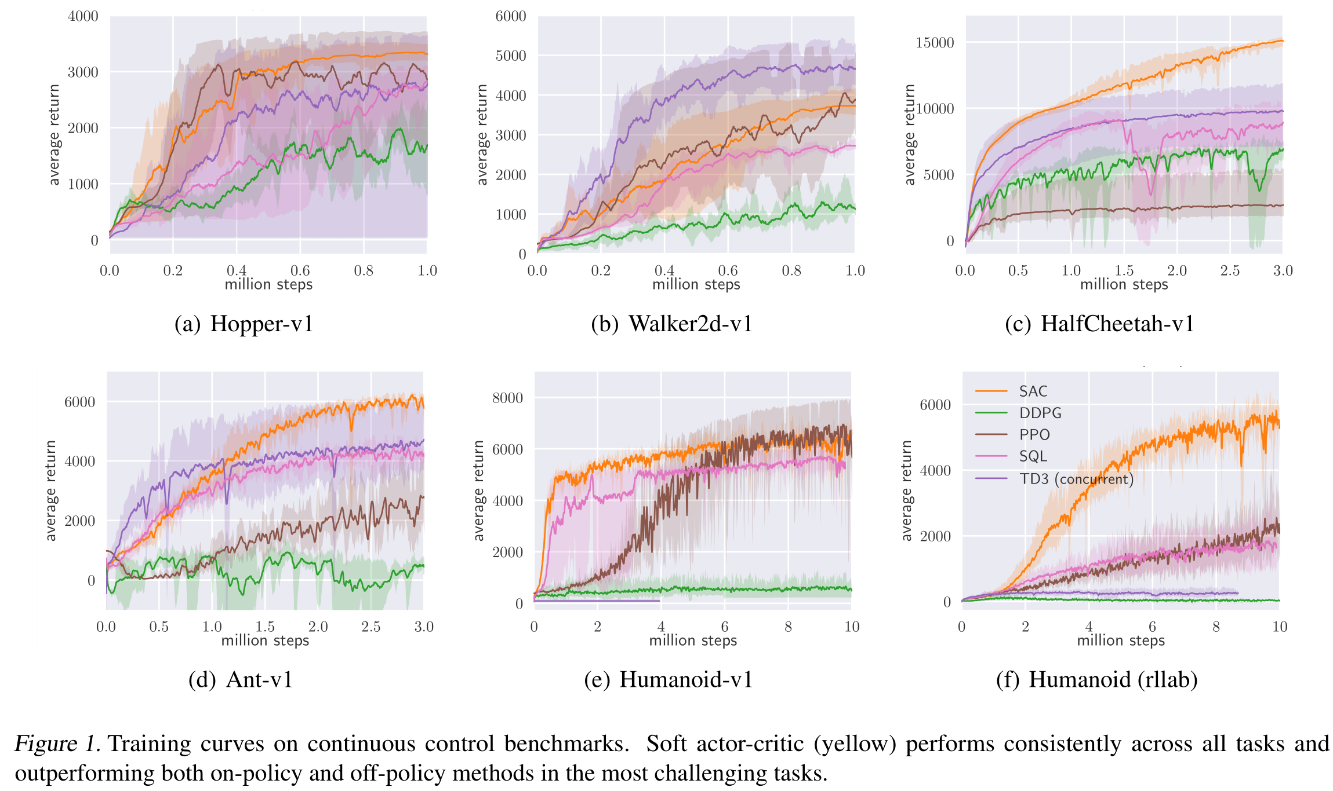
Results

Slide 14
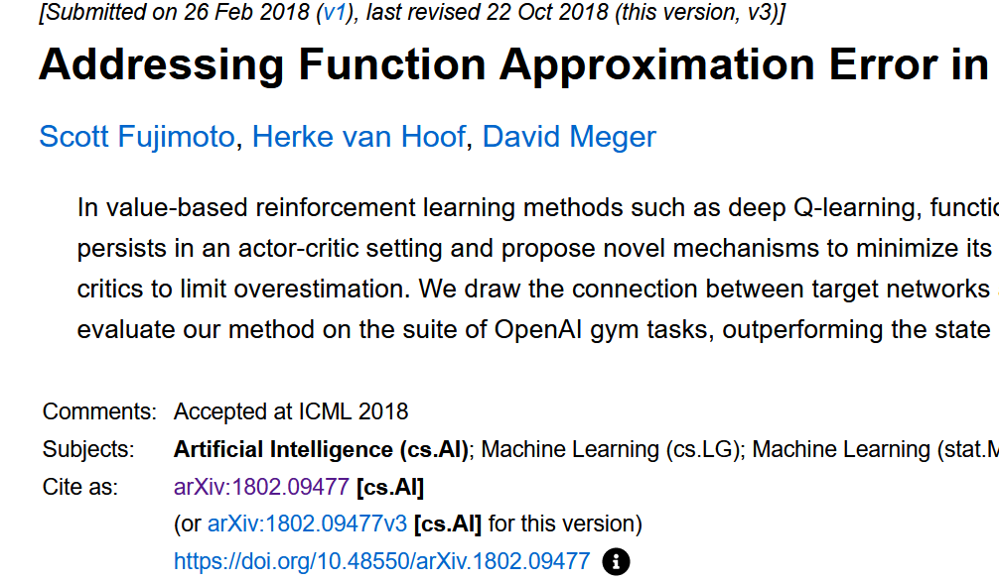
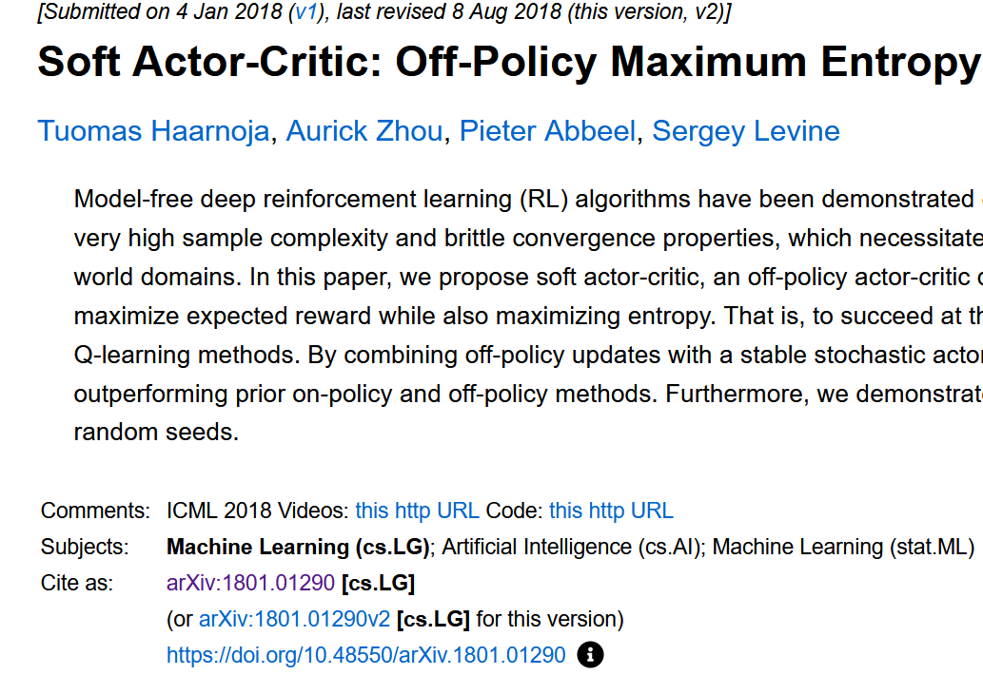
TD3 vs. SAC

Slide 15
TD3 vs. SAC
Similarities
Target Q-networks
Polyak averaging
Clipped Double-Q
Mean-squared Bellman Error (MSBE) minimization
Differences
SAC adds entropy term
SAC’s next action is freshly sampled from policy
TD3 uses target policy
TD3 uses explicit target policy smoothing

Slide 16
References
Lillicrap et al. 2016. Continuous Control With Deep Reinforcement Learning
Fujimoto et al, 2018. Addressing Function Approximation Error in Actor-Critic Methods
Haarnoja et al, 2018. Soft Actor-Critic: Off-Policy Maximum Entropy Deep Reinforcement Learning with a Stochastic Actor
Deep Deterministic Policy Gradient — Spinning Up documentation
Twin Delayed DDPG — Spinning Up documentation
Soft Actor-Critic — Spinning Up documentation
Kullback–Leibler divergence - Wikipedia
Abbeel, 2021. L5 DDPG and SAC (Foundations of Deep RL Series)

